Slide 1
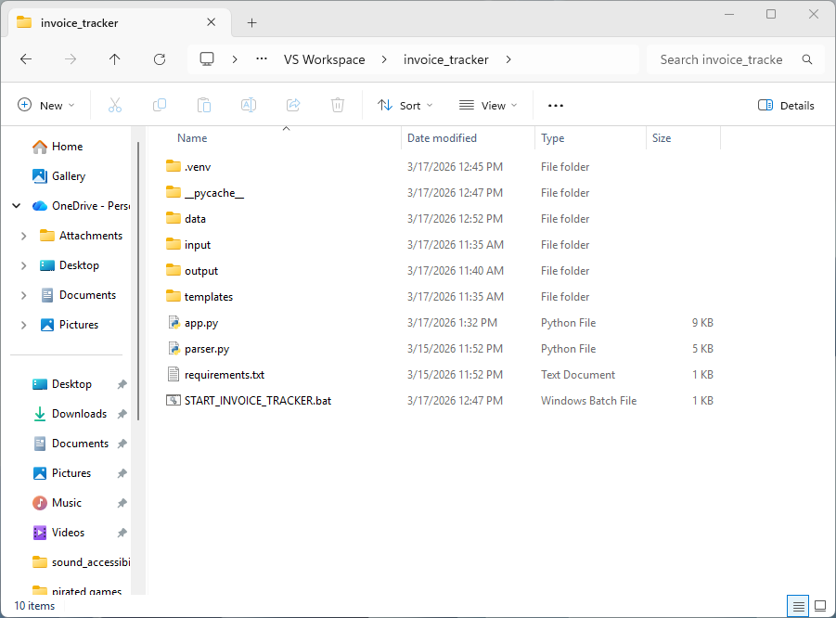

Slide 2
DELETE EVERYTHING INSIDE THESE FOLDERS

Slide 3
OPEN THIS FOLDER

Slide 4
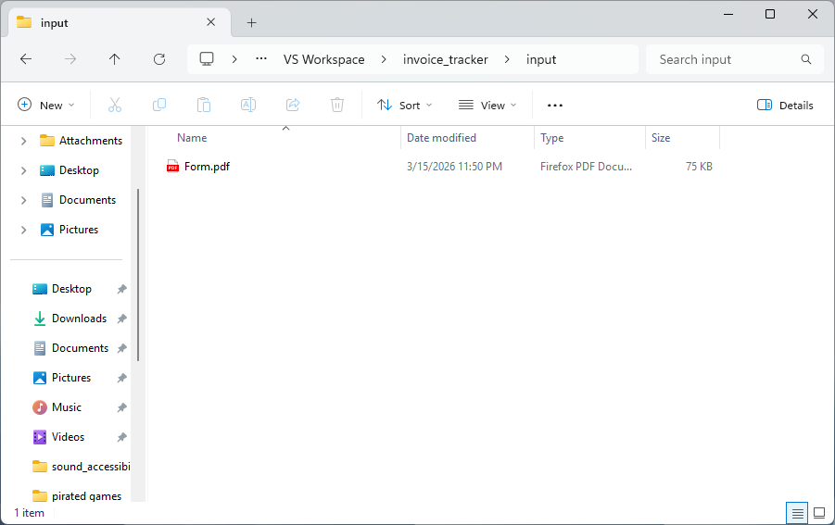
PLACE INVOICE, DOWNLOADED FROM STORE SITE HERE

Slide 5
GO BACK

Slide 6
OPEN THIS FILE,
READ BANNER & PRESS “ENTER”

Slide 7
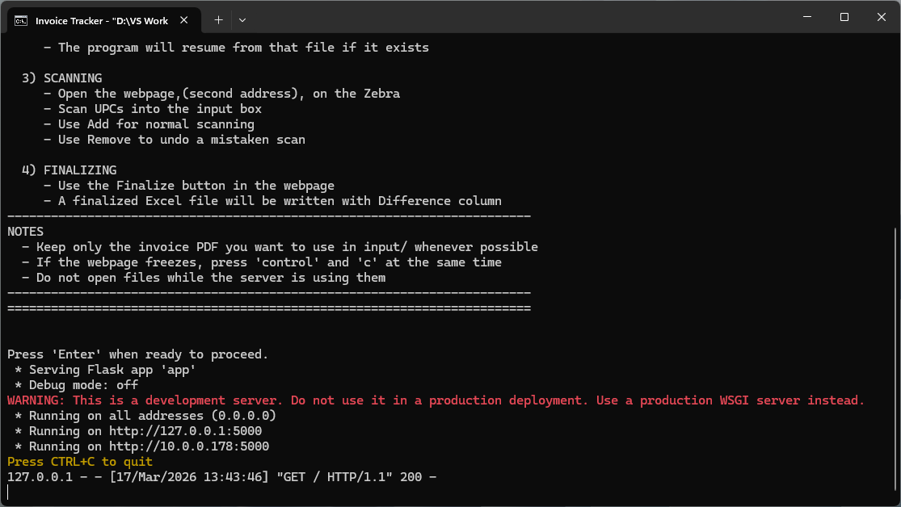
ON ZEBRA:
-OPEN “ESL” APP
-TAP SEARCH BAR
-ENTER SECOND ADDRESS

Slide 8
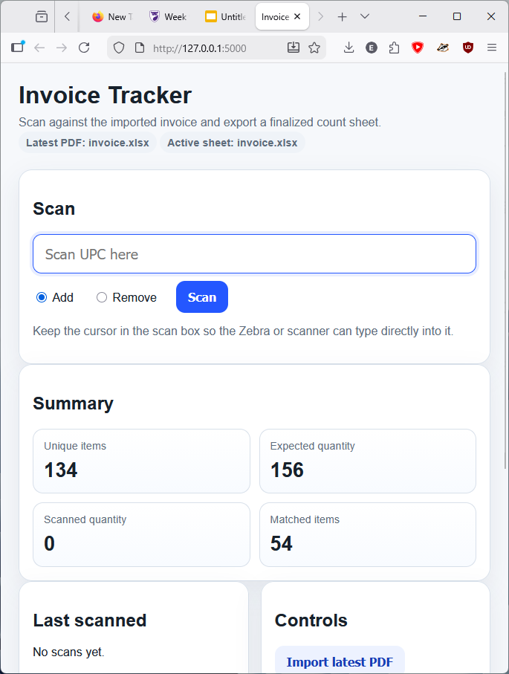
TAP “ADD” TO INCREMENT AN ITEM’S SCANNED QUANTITY
TAP “REMOVE TO DECREMENT AN ITEM’S SCANNED QUANTITY
UNIQUE ITEMS: TOTAL NUMBER OF UNIQUE ITEMS ON INVOICE
EXPECTED QUANTITY: TOTAL NUMBER OF ITEMS ON INVOICE
SCANNED QUANTITY: TOTAL NUMBER OF ITEMS SCANNED
MATCHED ITEMS: ITEMS WITH THE PROPER QUANTITY,(SCAN==EXP)

Slide 9
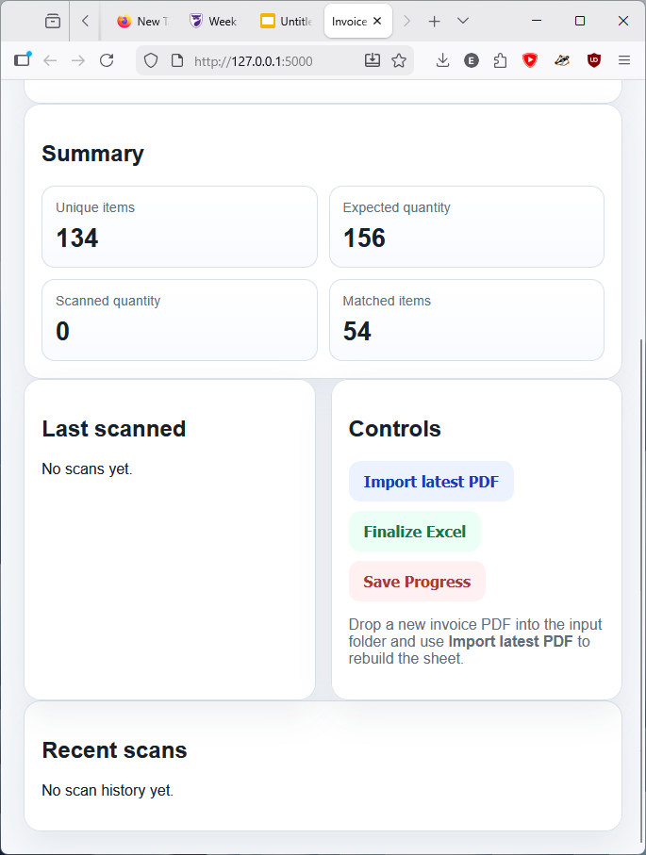
SHOWS LAST SCANNED ITEM
SHOWS LAST 15 SCANS
IMPORT LATEST PDF: CREATES NEW EXCEL BASED ON INPUT PDF, IN CASE PROGRAM STARTED WITH WRONG INVOICE
FINALIZE EXCEL: CREATES EXCEL THAT SHOWS DIFFERENCE BETWEEN EXPECTED QUANTITY AND SCANNED QUANTITY
SAVE PROGRESS: SAVES SCANNED QUANTITY TO EXCEL. PLEASE MAKE SURE EXCEL ISNT OPEN

